Slide 1


Slide 2
Technical Note 6
Waiting Line Management

Slide 3
OBJECTIVES
Waiting Line Characteristics
Suggestions for Managing Queues
Examples (Models 1, 2, 3, and 4)
Notes:
2

Slide 4

Components of the Queuing System
Servicing System
Servers
Queue or
Customer
Arrivals
Waiting Line
Exit
Notes:
3

Slide 5
Customer Service Population Sources
Population Source
Finite
Infinite
Example: Number of machines needing repair when a company only has three machines.
Example: The number of people who could wait in a line for gasoline.
Notes:
4

Slide 6
Service Pattern
Service
Pattern
Constant
Variable
Example: Items coming down an automated assembly line.
Example: People spending time shopping.
Notes:
5

Slide 7
The Queuing System
Length
Queuing
System
Queue Discipline
Number of Lines &
Line Structures
Service Time
Distribution

Slide 8
Examples of Line Structures
Single
Phase
Multiphase
One-person
barber shop
Car wash
Single Channel
Bank tellers’
windows
Hospital
admissions
Multichannel
Notes:
6

Slide 9
Degree of Patience
No Way!
No Way!
BALK
RENEG
Notes:
7

Slide 10
Suggestions for Managing Queues
1. Determine an acceptable waiting time for your customers
2. Try to divert your customer’s attention when waiting
3. Inform your customers of what to expect
4. Keep employees not serving the customers out of sight
5. Segment customers
Notes:
8

Slide 11
Suggestions for Managing Queues (Continued)
6. Train your servers to be friendly
7. Encourage customers to come during the slack periods
8. Take a long-term perspective toward getting rid of the queues
Notes:
9

Slide 12
Waiting Line Models
Source
Model
Layout
Population
Service Pattern
1
Single channel
Infinite
Exponential
2
Single channel
Infinite
Constant
3
Multichannel
Infinite
Exponential
4
Single or Multi
Finite
Exponential
These four models share the following characteristics:
•
Single phase
•
Poisson arrival
•
FCFS
•
Unlimited queue length
Notes:
10

Slide 13
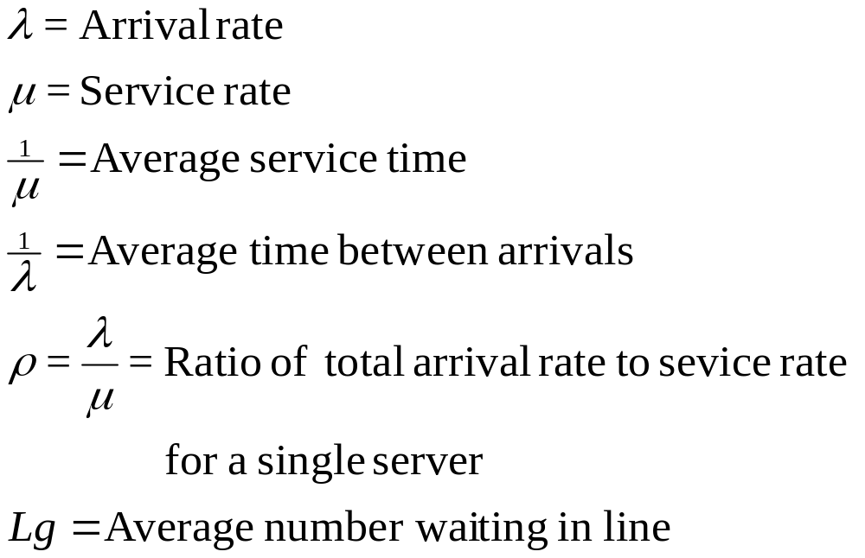
Notation: Infinite Queuing: Models 1-3

Slide 14
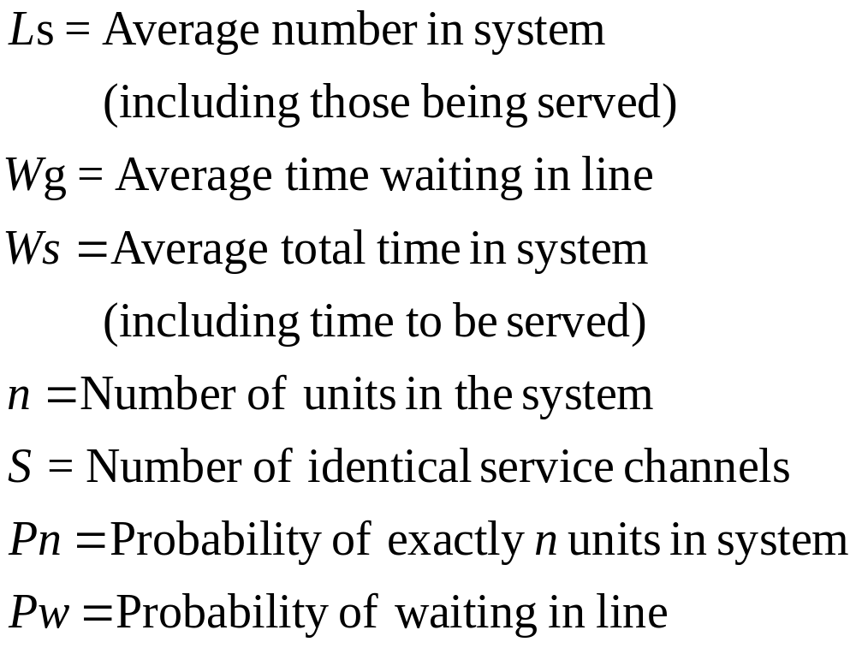
Infinite Queuing Models 1-3 (Continued)

Slide 15
Example: Model 1
Assume a drive-up window at a fast food restaurant.
Customers arrive at the rate of 25 per hour.
The employee can serve one customer every two minutes.
Assume Poisson arrival and exponential service rates.
Determine:
A) What is the average utilization of the employee?
B) What is the average number of customers in line?
C) What is the average number of customers in the system?
D) What is the average waiting time in line?
E) What is the average waiting time in the system?
F) What is the probability that exactly two cars will be
in the system?
Notes:
11

Slide 16
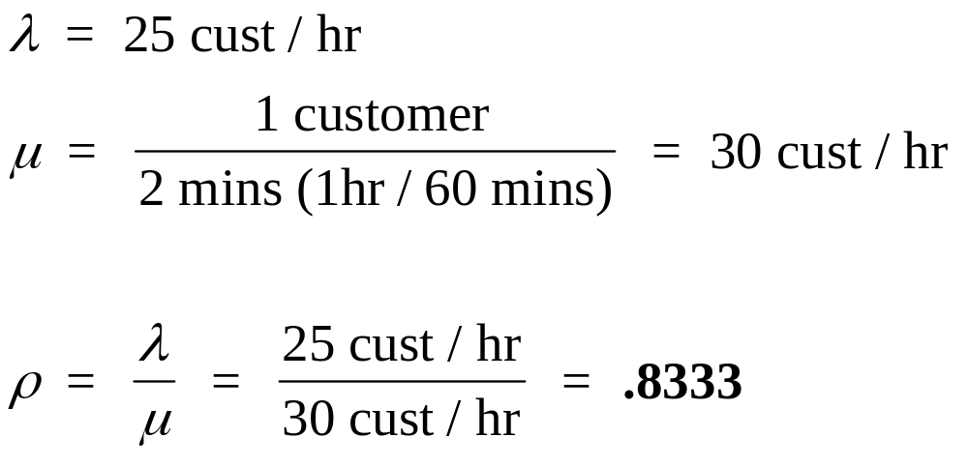
Example: Model 1
A) What is the average utilization of the employee?
Notes:
12

Slide 17
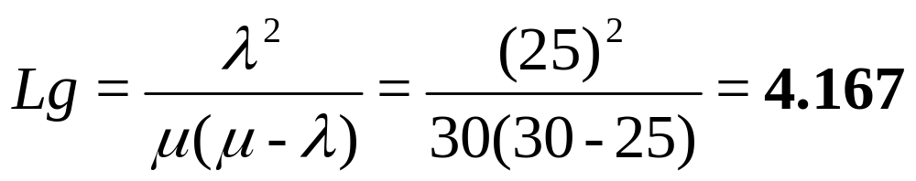
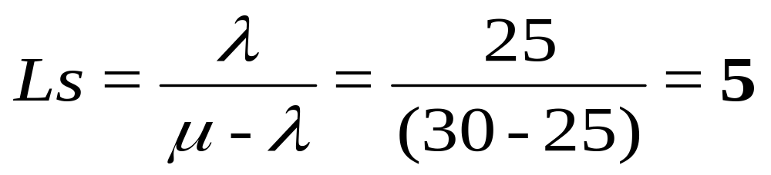
Example: Model 1
B) What is the average number of customers in line?
C) What is the average number of customers in the system?
Notes:
13

Slide 18
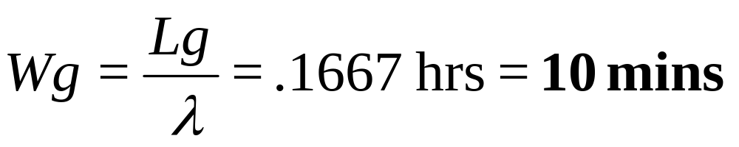
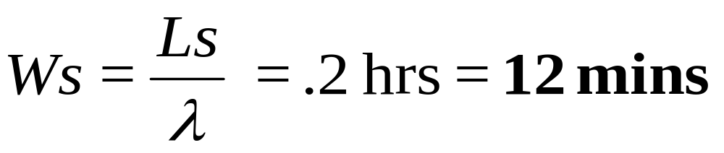
Example: Model 1
D) What is the average waiting time in line?
E) What is the average waiting time in the system?
Notes:
14

Slide 19
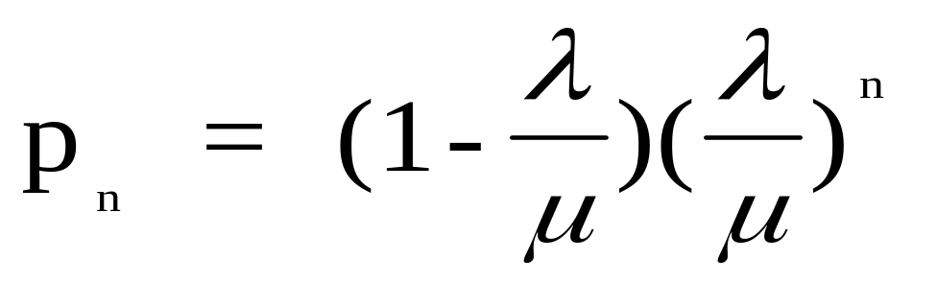
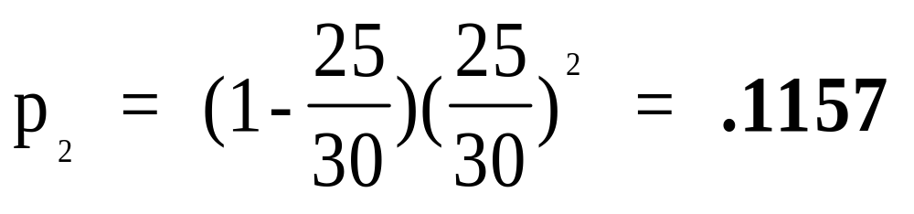
Example: Model 1
F) What is the probability that exactly two cars will be in the system (one being served and the other waiting in line)?
Notes:
15

Slide 20
Example: Model 2
An automated pizza vending machine heats and
dispenses a slice of pizza in 4 minutes.
Customers arrive at a rate of one every 6 minutes with the arrival rate exhibiting a Poisson distribution.
Determine:
A) The average number of customers in line.
B) The average total waiting time in the system.
Notes:
16

Slide 21
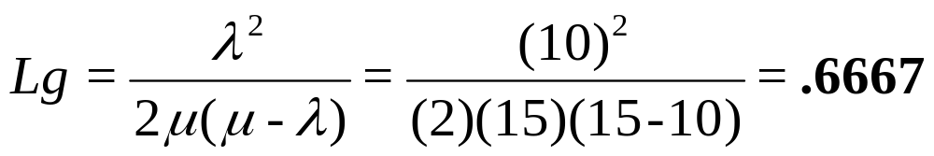
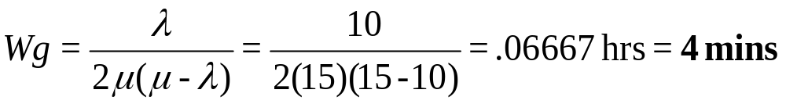
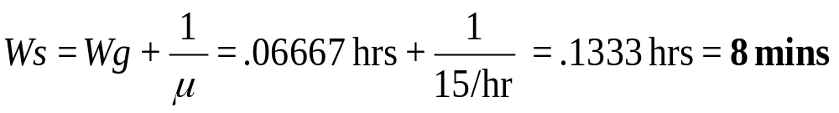
Example: Model 2
A) The average number of customers in line.
B) The average total waiting time in the system.
Notes:
17

Slide 22
Example: Model 3
Recall the Model 1 example:
Drive-up window at a fast food restaurant.
Customers arrive at the rate of 25 per hour.
The employee can serve one customer every two minutes.
Assume Poisson arrival and exponential service rates.
If an identical window (and an identically trained server) were added, what would the effects be on the average number of cars in the system and the total time customers wait before being served?
Notes:
18

Slide 23
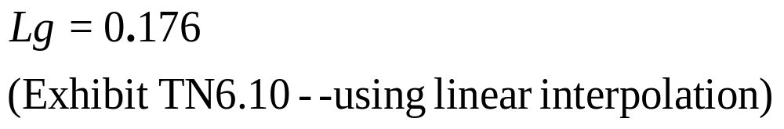
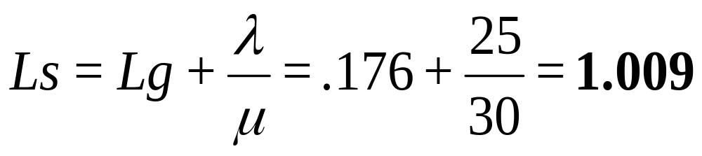
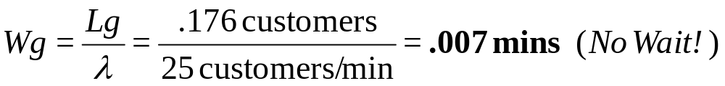
Example: Model 3
Average number of cars in the system
Total time customers wait before being served
Notes:
19

Slide 24
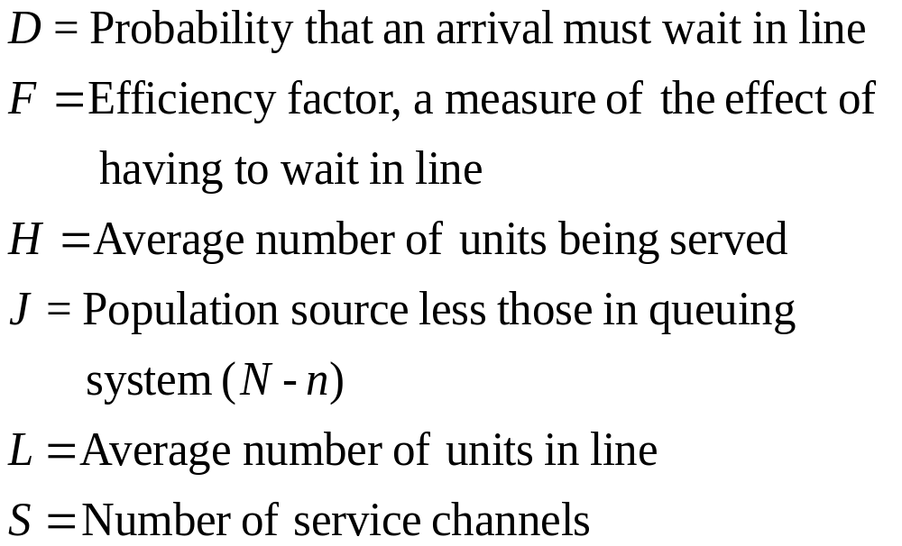
Notation: Finite Queuing: Model 4

Slide 25
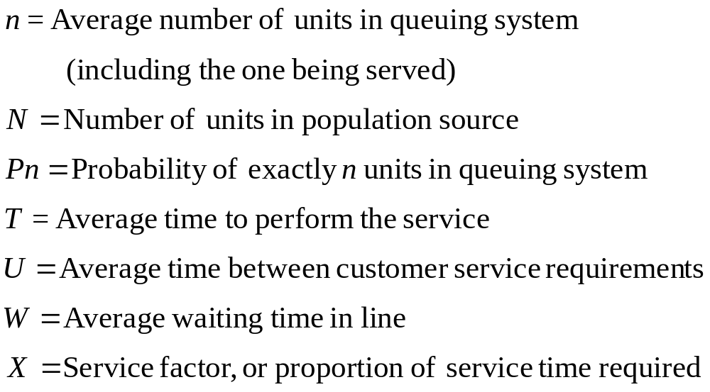
Finite Queuing: Model 4 (Continued)

Slide 26
Example: Model 4
The copy center of an electronics firm has four copy
machines that are all serviced by a single technician.
Every two hours, on average, the machines require
adjustment. The technician spends an average of 10
minutes per machine when adjustment is required.
Assuming Poisson arrivals and exponential service,
how many machines are “down” (on average)?
Notes:
20

Slide 27
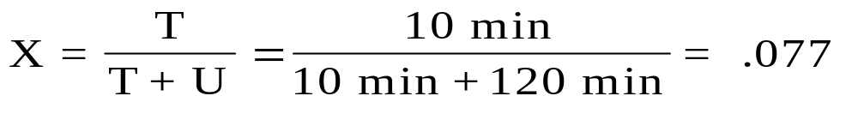
Example: Model 4
N, the number of machines in the population = 4
M, the number of repair people = 1
T, the time required to service a machine = 10 minutes
U, the average time between service = 2 hours
From Table TN6.11, F = .980 (Interpolation)
L, the number of machines waiting to be
serviced = N(1-F) = 4(1-.980) = .08 machines
H, the number of machines being
serviced = FNX = .980(4)(.077) = .302 machines
Number of machines down = L + H = .382 machines
Notes:
21

Slide 28
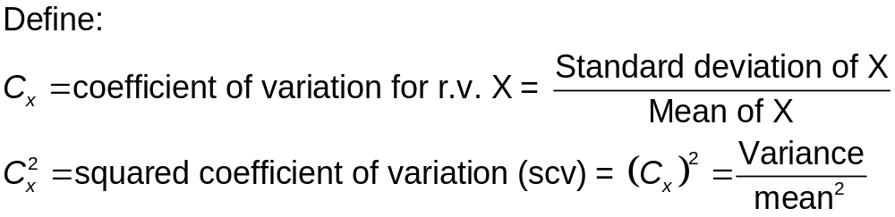
Queuing Approximation
This approximation is quick way to analyze a queuing situation. Now, both interarrival time and service time distributions are allowed to be general.
In general, average performance measures (waiting time in queue, number in queue, etc) can be very well approximated by mean and variance of the distribution (distribution shape not very important).
This is very good news for managers: all you need is mean and standard deviation, to compute average waiting time

Slide 29

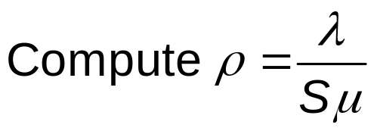
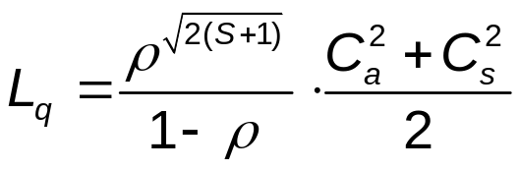
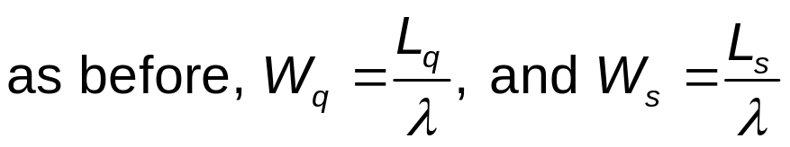

Queue Approximation
Inputs: S, λ, μ,
(Alternatively: S, λ, μ, variances of interarrival and service time distributions)

Slide 30
Approximation Example
Consider a manufacturing process (for example making plastic parts) consisting of a single stage with five machines. Processing times have a mean of 5.4 days and standard deviation of 4 days. The firm operates make-to-order. Management has collected date on customer orders, and verified that the time between orders has a mean of 1.2 days and variance of 0.72 days. What is the average time that an order waits before being worked on?
Using our “Waiting Line Approximation” spreadsheet we get:
  L_{q} = 3.154 Expected number of orders waiting to be completed.
  Wq = 3.78 Expected number of days order waits.
  Ρ = 0.9 Expected machine utilization.

Slide 31
End of Technical Note 6

